Slide 1
Kansas City Housing Data
Venkata Rohil Wardhan Kancharla, Grace Milton, Vishal Raman
Github repo (https://github.com/Vishal613/House-Price-Prediction)

Slide 2
Visualization

Slide 3
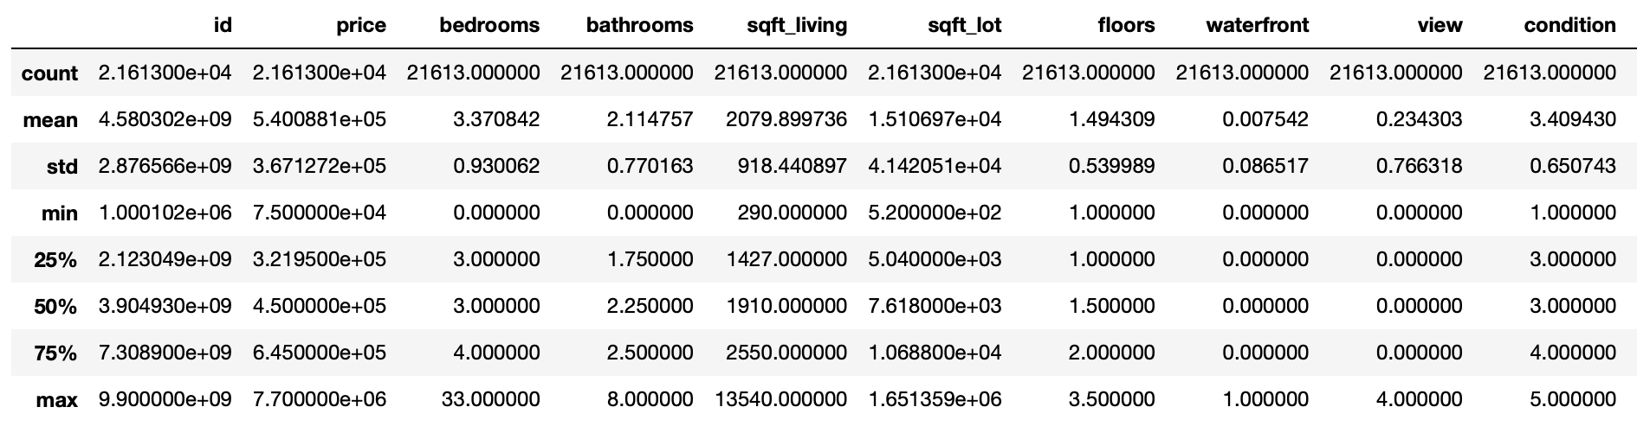
Data Summary
21613 instances, 21 variables

Slide 4
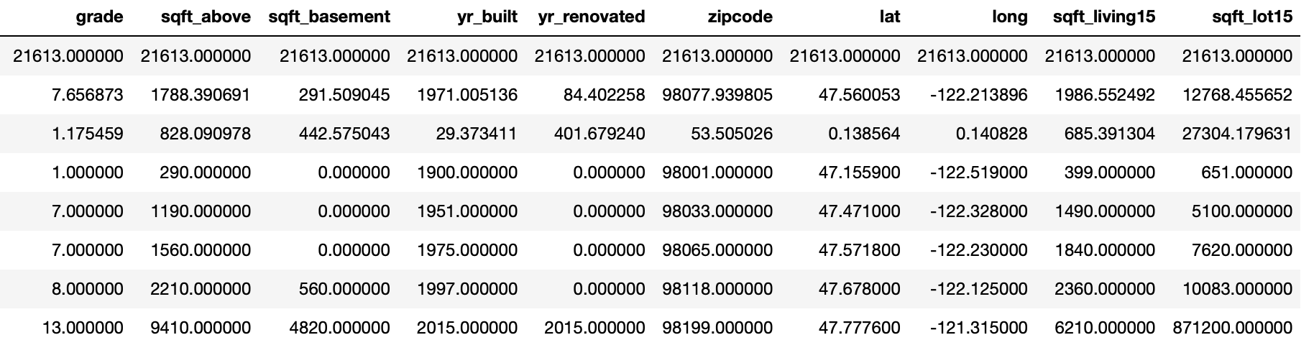
Data Summary (continued)

Slide 5
Variables
id
date
price
bedrooms
bathrooms
sqft_living
sqft_lot
floors
waterfront
view
condition
grade
sqft_above
sqft_basement
yr_built
yr_renovated
zipcode
lat
long
sqft_living15
sqft_lot15

Slide 6
Initial Visualizations

Slide 7
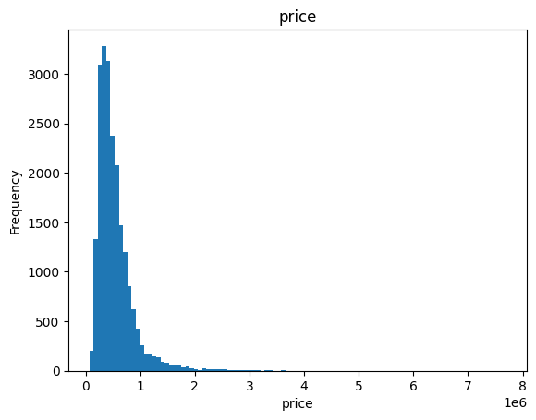
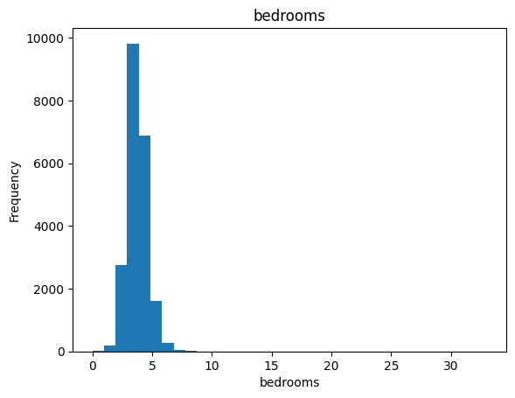
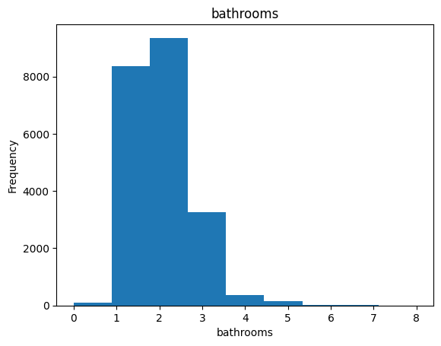
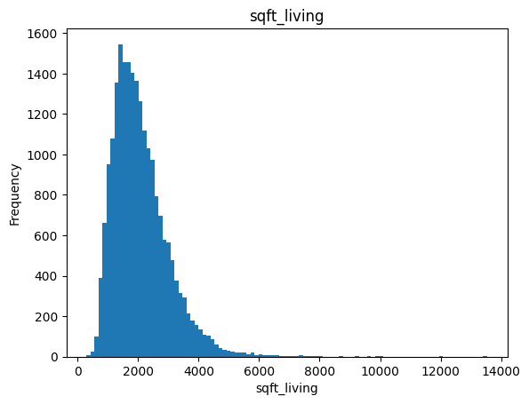
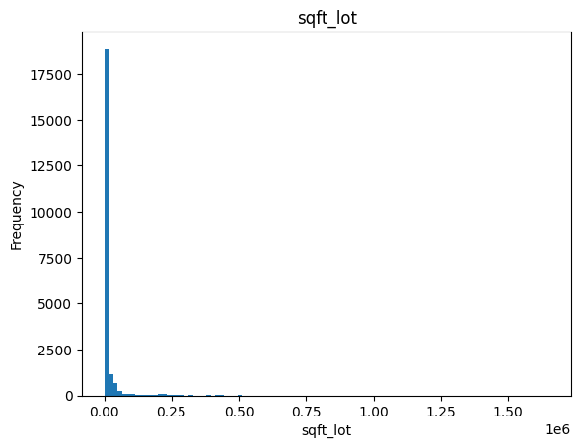
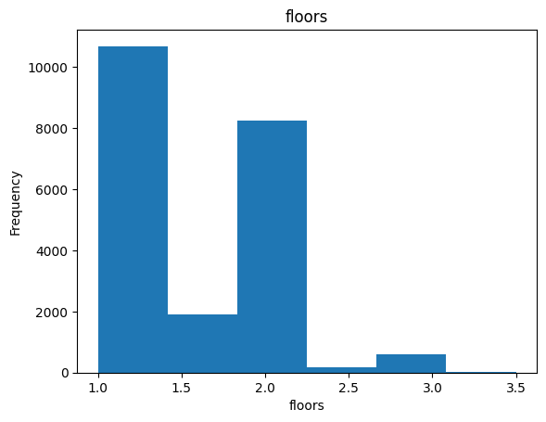

Slide 8
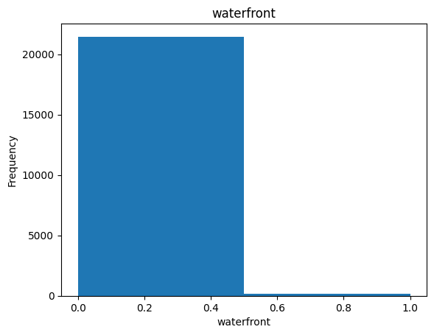
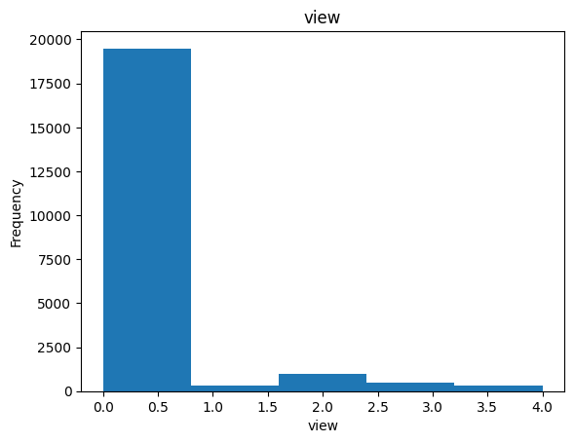
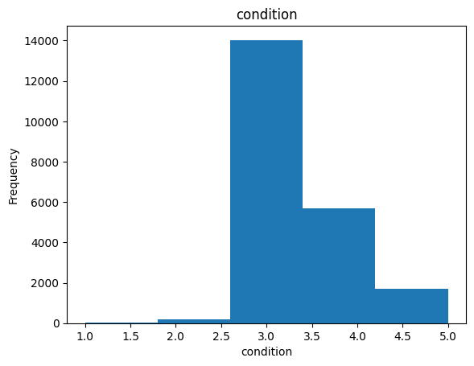
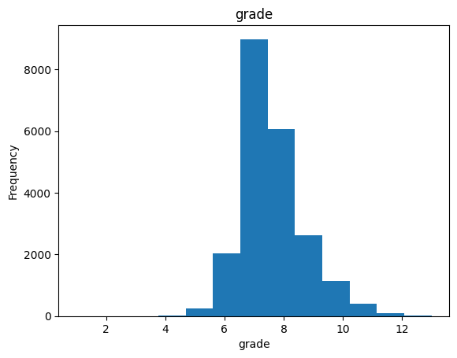
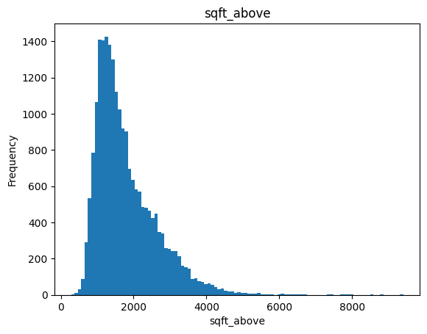
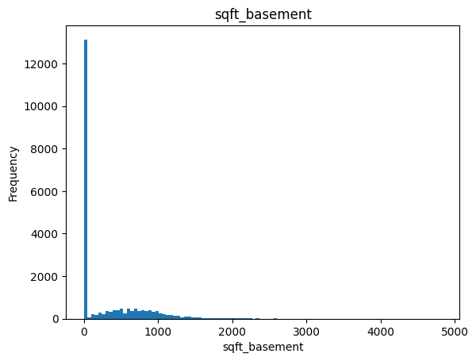

Slide 9
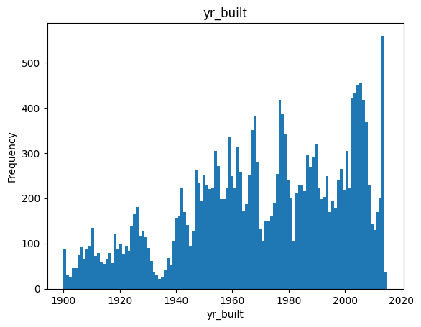
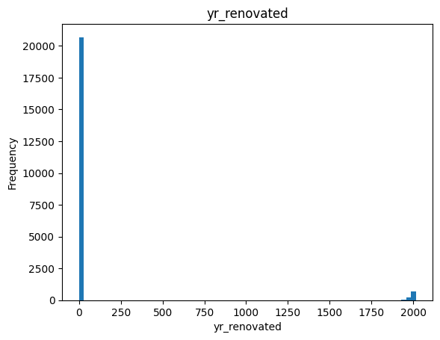
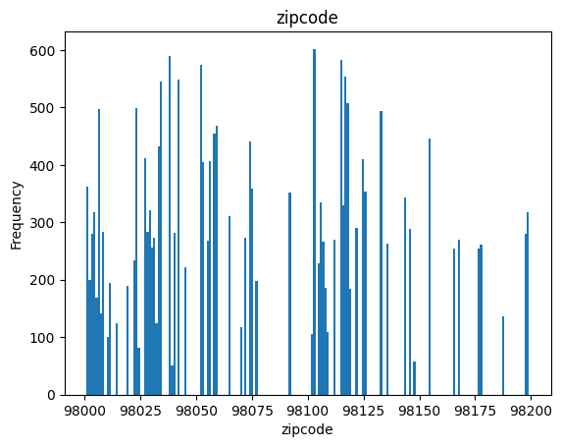
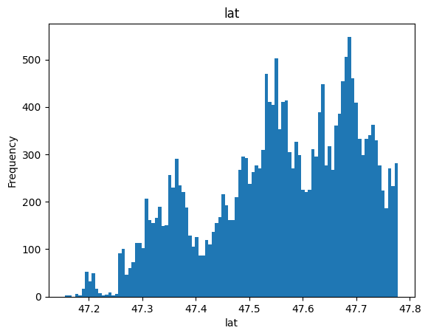
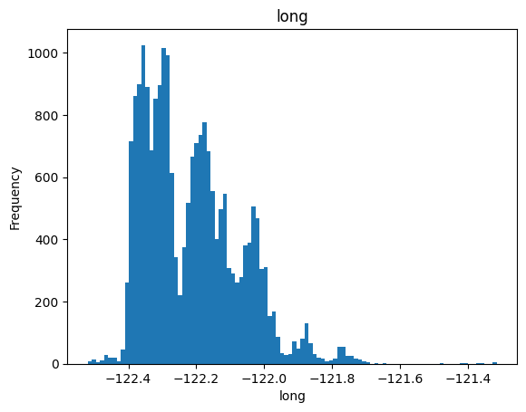

Slide 10
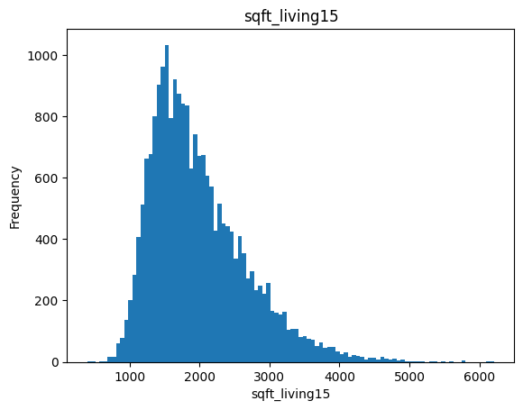
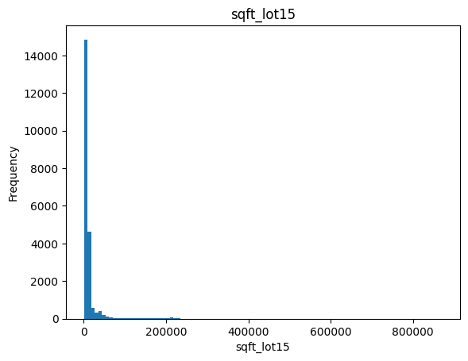

Slide 11
Correlations and Pearson Coefficients

Slide 12
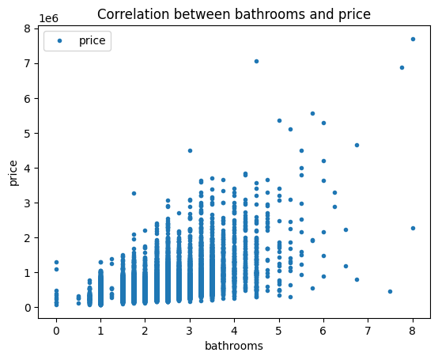
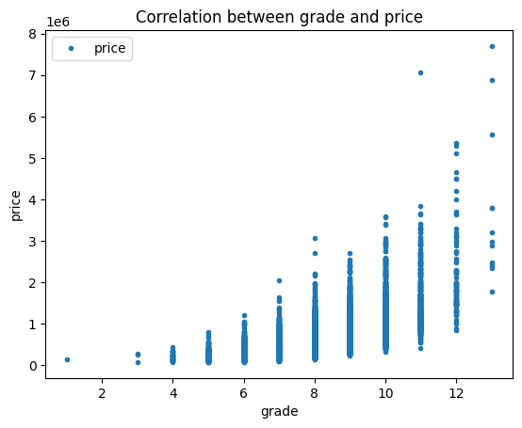
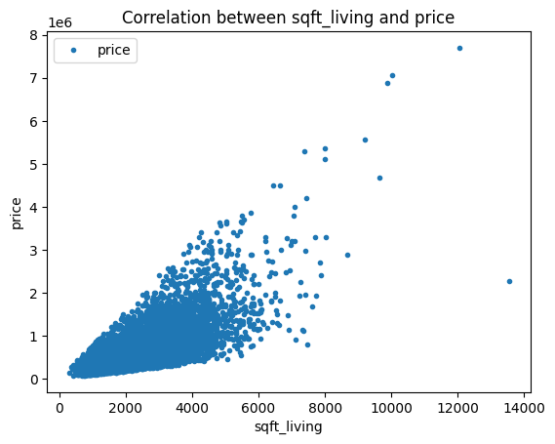
Pearson coefficient = 0.525
Pearson coefficient = 0.667
Pearson coefficient = 0.702

Slide 13
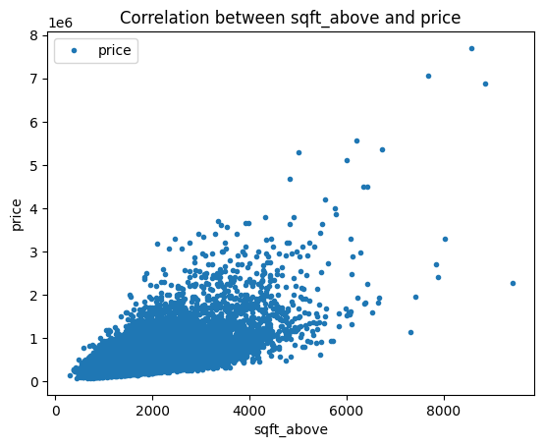
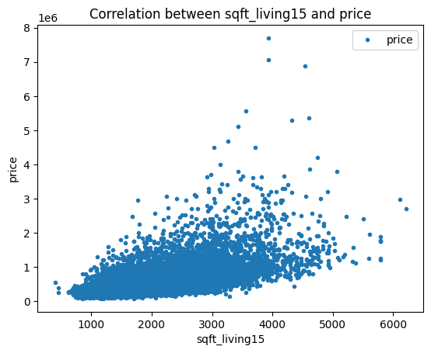
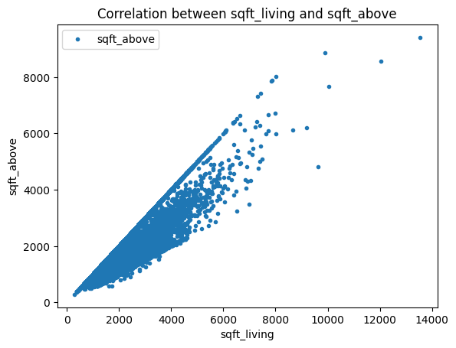
Pearson coefficient = 0.606
Pearson coefficient = 0.585
Pearson coefficient = 0.877

Slide 14
Model Building

Slide 15
Ridge Regression
The data was split into 70% training and 30% test data.
A Ridge regression model was trained using the train dataset.
Preprocessing:
Id column contained more than 99% unique values and hence it was removed since it won’t be useful to the model.
The data didn’t have any Null values.
Date column was Label encoded since there is a certain order to date, and the Label encoder preserves this order.
Zipcode variable was One hot encoded since there is no order to zipcodes, and keeping them as such might make the model give them a certain false order.
The input variables were scaled to obtain a mean value of 0 and standard deviation value of 1.
The variable ‘sqft_above’ is highly correlated with sqft_living. But the variable wasn’t removed for modelling to check how Ridge/Lasso regression is able to handle this.

Slide 16
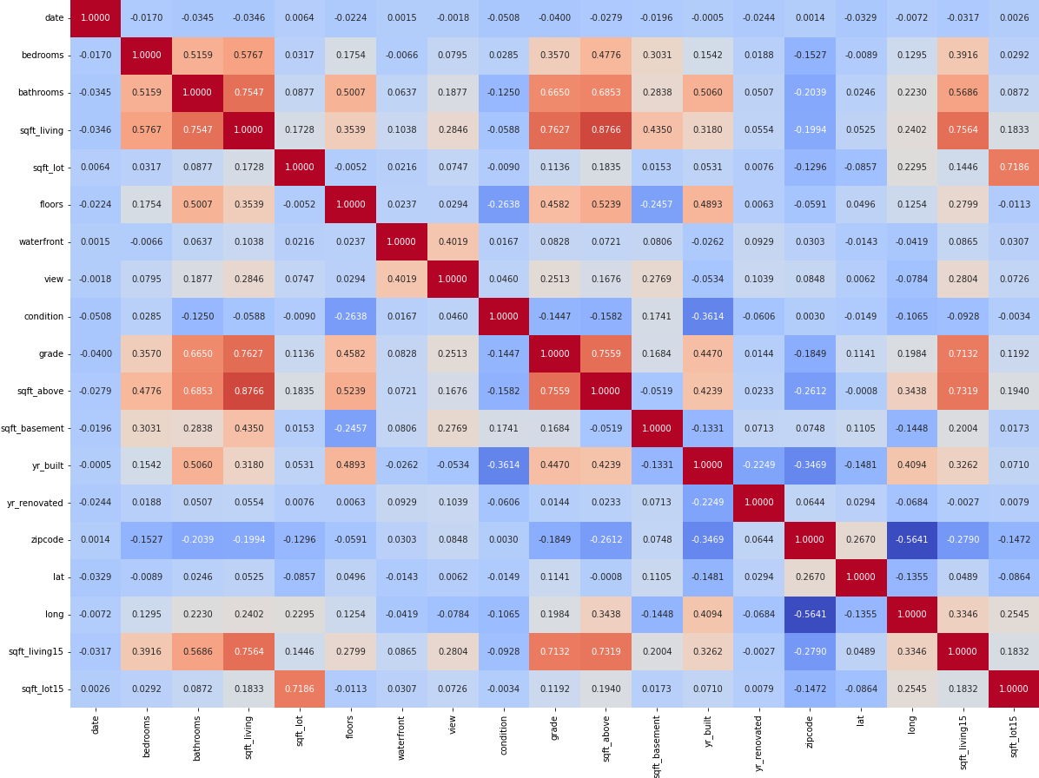
Correlation plot

Slide 17
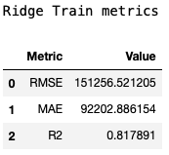
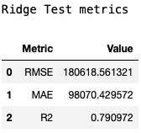
Results
The best value of alpha is chosen using RidgeCV method in Python.
Using the best alpha obtained, the model is fitted to the training data.

Slide 18
Cross validation results
The R2 scores are less in comparison to the score we got before, meaning the model isn’t generalising that well.

Slide 19
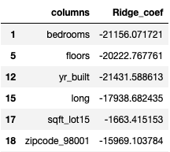

Predictor contributions

Slide 20
Lasso Regression
The data was split into 70% training and 30% test data.
A Lasso regression model was trained using the train dataset.
Preprocessing:
Same as done in Ridge regression.

Slide 21
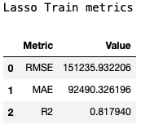
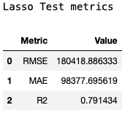
Results
The best value of alpha is chosen using LassoCV method in Python.
Using the best alpha obtained, the model is fitted to the training data.

Slide 22
Cross validation results
The R2 scores are similar to the score we got before, meaning the model is generalising well. The Lasso model is able to handle collinearity in variables better than the Ridge model.

Slide 23
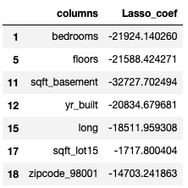

Predictor contributions

Slide 24
Linear Regression
Linear Regression describes the relationship between independent and dependent variables by fitting a linear equation to the observed data.
Linear Regression is best used for continuous variable with any level of measurement
The dataset is split into 70% train data and 30% test data

Slide 25
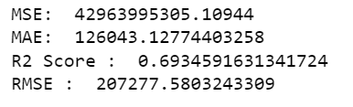
Results
Evaluation Metrics -

Slide 26
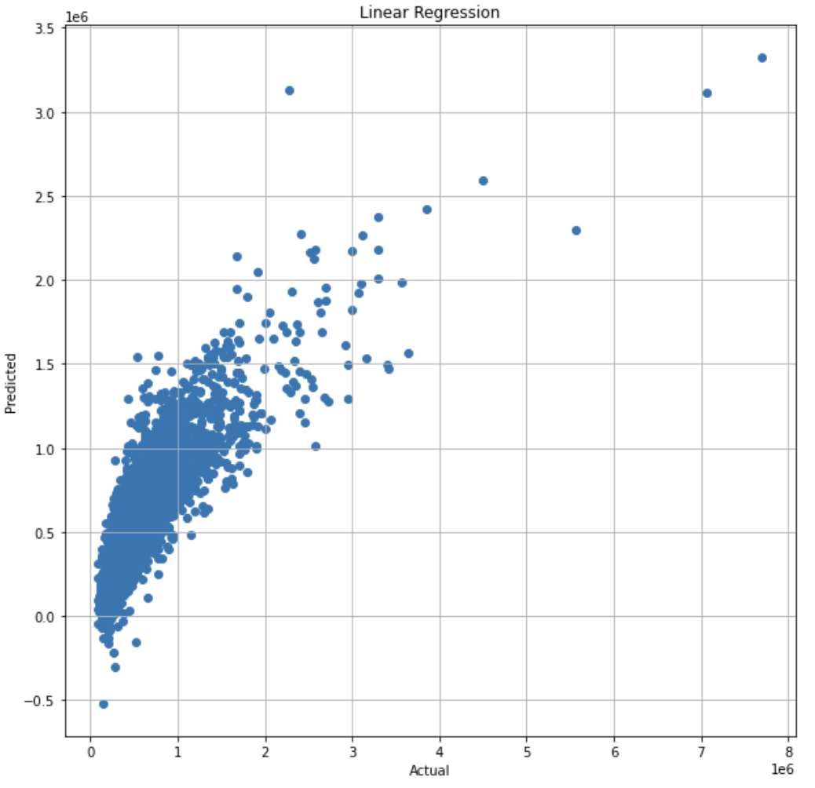
Visualization Graph for Linear Regression-

Slide 27
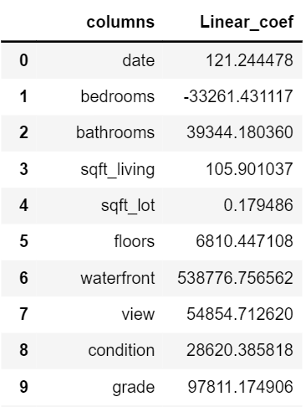
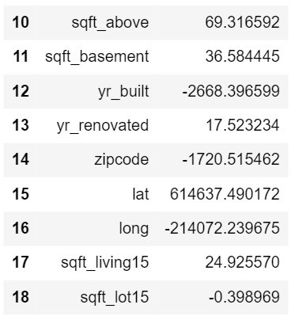
Predictor Contribution for Linear Regression

Slide 28
KNN Regression
KNN regression is a supervised ML model to predict the value of output variable by using local average
KNN approximates the continuous association between independent variables and the continuous outcome by averaging the observations of the same neighbourhood
The dataset is split into 70% train data and 30% test data

Slide 29
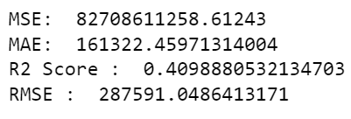
Results
Evaluation Metrics -

Slide 30
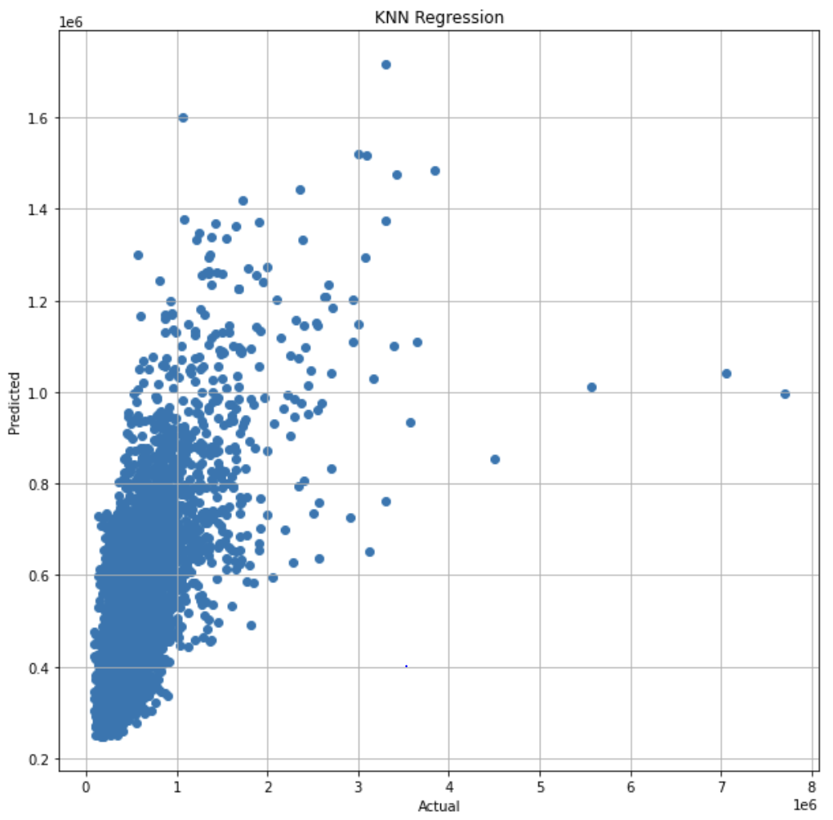
Visualization Graph for KNN-

Slide 31
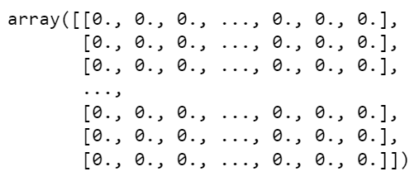
Predictor Contributions for KNN
Since KNN is a nearest neighbour, Coefficients cannot be obtained. Instead, we made a neighbours graphs and mapped it to array

Slide 32
Estimation stability

Slide 33
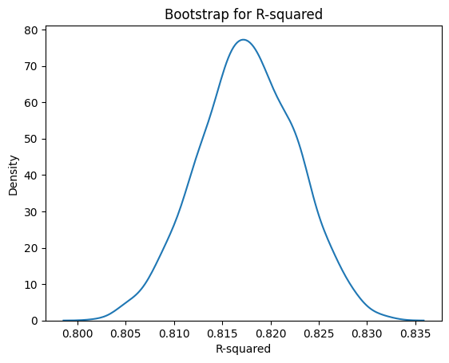
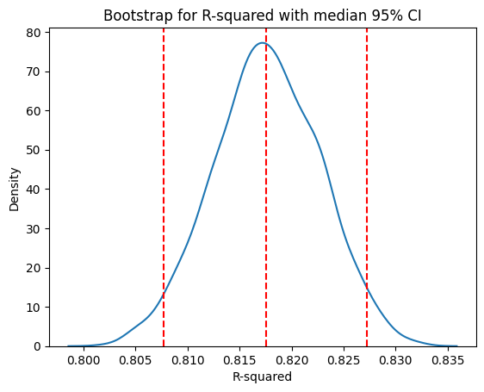
Bootstrap - Lasso

Slide 34
Thank you!

